Slide 1



SALARY SURVEY ANALYSIS
for 2021
KOWSALYA J
DADS-OCT BATCH

Slide 2
SUMMARY
Analyzed the annual salary survey, cleaned the raw dataset, extracted and queried data for dashboard development, and created a dashboard to visualize trends and insights.

Slide 3

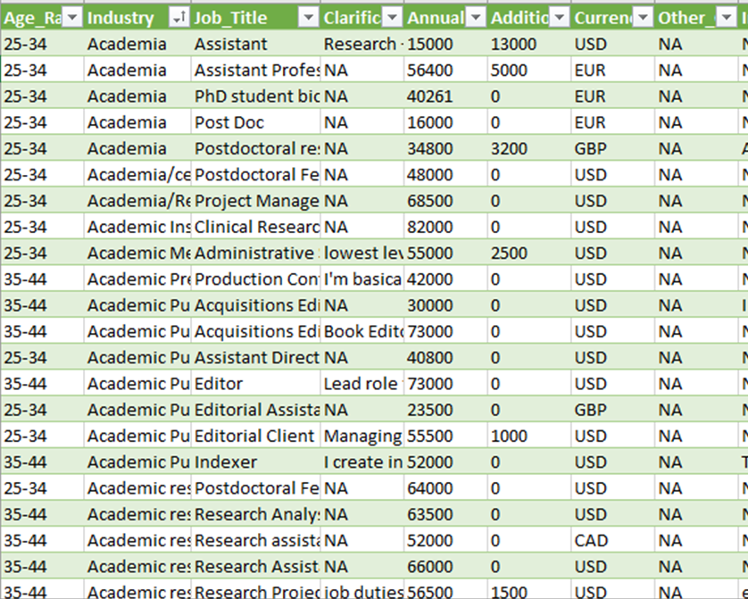
PIVOT TABLE AND CHARTS
The dataset is about salary survey for the year 2021
Handled missing values.
Inconsistent values.
Standardized data types

Slide 4

PIVOT TABLE AND CHARTS
Created Pivot Tables and charts.
Added Slicers.
Implemented KPI’s.

Slide 5
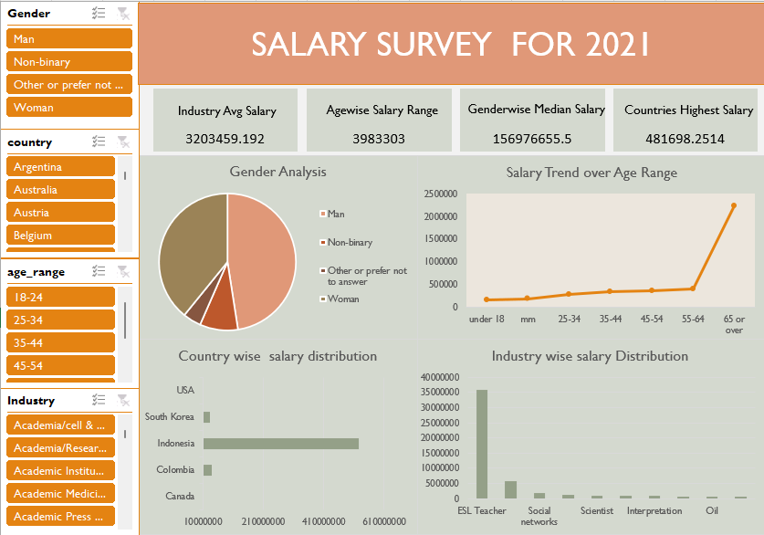

Slide 6
INSIGHTS
PhD Scholars - highest salary range.
More experience – More Salary.
“Computing or tech” - High no. of employees.
Experienced people – men’s Salary is High.
“Investment banking Analyst” - High salary.
Seoul tops the list and it is by ESL Teachers.

Slide 7
CONCLUSION & RECOMMENDATIONS
Women dominate among younger generations.
Focus on recruiting talent irrespective of gender.
Other industries should strive for development.

Slide 8

THANK YOU

